Slide 1
Matthew 6:19-24
Rod Thom

Slide 3
X MARKS THE SPOT

Slide 4
Matthew 6:19-24 (NIV)
v19 “Do not store up for yourselves treasures on earth, where moths and vermin destroy, and where thieves break in and steal. 20 But store up for yourselves treasures in heaven, where moths and vermin do not destroy, and where thieves do not break in and steal. 21 For where your treasure is, there your heart will be also.

Slide 5
Matthew 6:19-24 (NIV)
v22 “The eye is the lamp of the body. If your eyes are healthy,[c] your whole body will be full of light. 23 But if your eyes are unhealthy,[d] your whole body will be full of darkness. If then the light within you is darkness, how great is that darkness!

Slide 6
Matthew 6:19-24 (NIV)
v24 “No one can serve two masters. Either you will hate the one and love the other, or you will be devoted to the one and despise the other. You cannot serve both God and money.

Slide 7
The 2 TREASURES of the HEART
v19 “Do not store up for yourselves treasures on earth, where moths and vermin destroy, and where thieves break in and steal. 20 But store up for yourselves treasures in heaven, where moths and vermin do not destroy, and where thieves do not break in and steal. 21 For where your treasure is, there your heart will be also.

Slide 8
The 2 TREASURES of the HEART
to give appropriate care for one’s own family (1 Thess. 4:11 – 12; 2 Thess. 3:6 – 15; 1 Tim. 5:8)
to help those who are in need, especially the family of faith (Prov. 19:17; Acts 11:27 – 30; Rom. 15:25 – 27; 2 Cor 8:1 – 15; Gal. 6:7 – 10; Eph. 4:28; 1 Tim. 5:3 – 7); and
to encourage and support God’s work in spreading the gospel of the kingdom both at home and around the world (1 Cor. 9:3 – 14; Phil. 4:14 – 19; 1 Tim. 5:17 – 18).

Slide 9
The 2 TREASURES of the HEART
• Security
• Personal worth, esteem, and value
• Power
• Independence
• Pleasure

Slide 10
THE 2 EYES of the HEART
v22 “The eye is the lamp of the body. If your eyes are healthy,[c] your whole body will be full of light. 23 But if your eyes are unhealthy,[d] your whole body will be full of darkness. If then the light within you is darkness, how great is that darkness!

Slide 11
The 2 MASTERS of the HEART
v24 “No one can serve two masters. Either you will hate the one and love the other, or you will be devoted to the one and despise the other. You cannot serve both God and money.

Slide 12
“Many perceptive observers have sensed that the greatest danger to Western Christianity is not, as is sometimes alleged, prevailing ideologies such as Marxism, Islam, the New Age movement or humanism but rather the all-pervasive materialism of our affluent culture. We try so hard to create heaven on earth and to throw in Christianity when convenient as another small addition to the so-called good life. Jesus proclaims that unless we are willing to serve him wholeheartedly in every area of life, but particularly with our material resources, we cannot claim to be serving him at all.”

Slide 13
X MARKS THE SPOT…

Slide 14
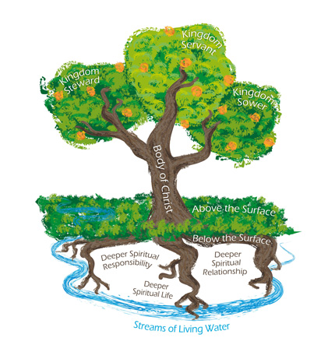
X MARKS THE SPOT…

