Slide 1
Matthew 5:43-48
Rod Thom

Slide 2
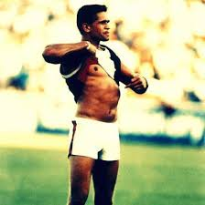
GAME CHANGER
“A Game Changer is an event, idea, or procedure that effects a significant shift in the current way of doing or thinking about something.”

Slide 3
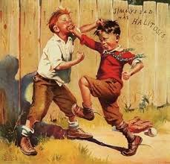
Matthew 5:43-47 (MSG)
“You’re familiar with the old written law, ‘Love your friend,’ and its unwritten companion, ‘Hate your enemy.’

Slide 4
Matthew 5:43-47 (MSG)
I’m challenging that.
I’m telling you to love your enemies. Let them bring out the best in you, not the worst.

Slide 5
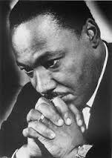
Matthew 5:43-47 (MSG)
When someone gives you a hard time, respond with the energies of prayer, for then you are working out of your true selves, your God-created selves.

Slide 6
1. Love your enemy by PRAYING for them

Slide 7
-Pray for the Spirit to help you…
-Pray that God will rescue them from the dominion of darkness and bring them "into the kingdom of the Son He loves, in whom we have redemption, the forgiveness of sins" (Colossians 1:13-14).
-Pray that they will "put to death whatever belongs to [their] earthly nature: sexual immorality, impurity, lust, evil desires and greed, which is idolatry" (Colossians 3:5).
-Pray that they will rid themselves of "anger, rage, malice, slander, and filthy language from [their] lips" (Colossians 3:8).
-Pray that they will become one of God’s children, holy and dearly loved, clothed with compassion, kindness, humility, gentleness and patience (Colossians 3:12).
-Pray they will come to know and possess the love of Jesus (Colossians 3:14).

Slide 8
Matthew 5:43-47 (MSG)
This is what God does. He gives his best—the sun to warm and the rain to nourish—to everyone, regardless: the good and bad, the nice and nasty. If all you do is love the lovable, do you expect a bonus? Anybody can do that. If you simply say hello to those who greet you, do you expect a medal? Any run-of-the-mill sinner does that.

Slide 9
2. Love your enemy because this is what God does!
Matthew 5:9 (NIV) Blessed are the peacemakers, for they will be called children of God.

Slide 10
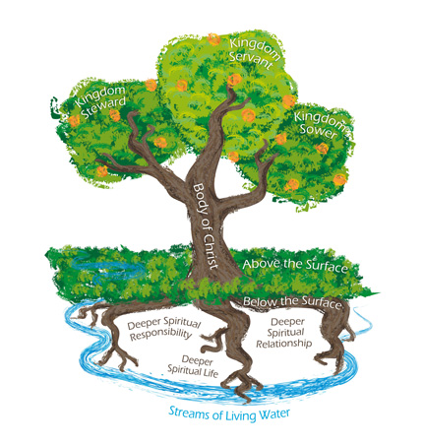
Matthew 5:48 (MSG)
“In a word, what I’m saying is, Grow up. You’re kingdom subjects. Now live like it.

Slide 11
Oliver Wendell Holmes SR
“Most people are willing to take The Sermon on the Mount as a flag to sail under but few will use it as a rudder by which to steer.”

Slide 12
Matthew 5:48 (MSG)
Live out your God-created identity. Live generously and graciously toward others, the way God lives toward you.”

