Slide 2
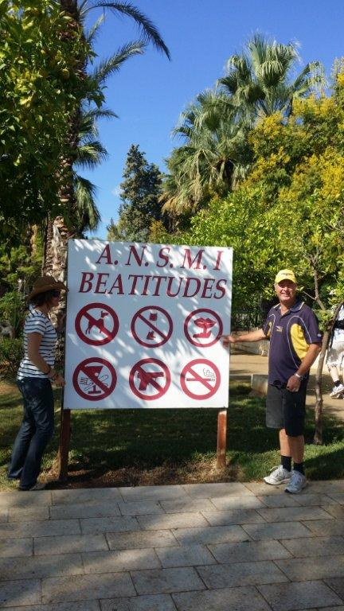

Slide 3
Matthew 5
21 “You have heard that it was said to the people long ago, ‘You shall not murder, and anyone who murders will be subject to judgment.’ 22 But I tell you that anyone who is angry with a brother or sister will be subject to judgment. Again, anyone who says to a brother or sister, ‘Raca,’ is answerable to the court. And anyone who says, ‘You fool!’ will be in danger of the fire of hell.

Slide 4
23 “Therefore, if you are offering your gift at the altar and there remember that your brother or sister has something against you, 24 leave your gift there in front of the altar. First go and be reconciled to them; then come and offer your gift.

Slide 5
25 “Settle matters quickly with your adversary who is taking you to court. Do it while you are still together on the way, or your adversary may hand you over to the judge, and the judge may hand you over to the officer, and you may be thrown into prison. 26 Truly I tell you, you will not get out until you have paid the last penny.

Slide 6
Jewish people then were very dependent on Pharisees and religious leaders for the teaching

Slide 7
Jesus sets Himself up as the authority…
the Word

Slide 8
Raca…

Slide 9
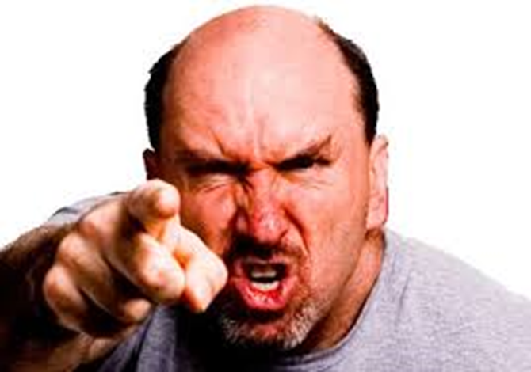
Anger is murder…

Slide 10
What about righteous anger?

Slide 11
What do you do with anger?

Slide 13
Praise God for Jesus

