Slide 1
Matthew 5:7-12
Rod Thom

Slide 2
Next Week at Lifestreams Krish Kandia

Slide 3
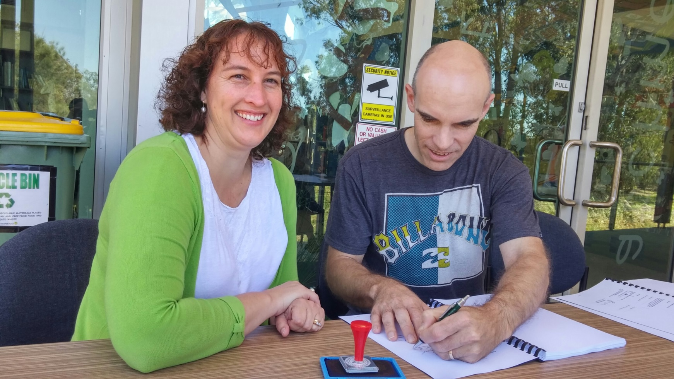
The Signing of the Lease

Slide 4
Matthew 5:7-12
Rod Thom

Slide 5
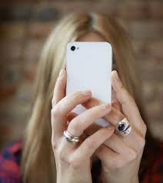
The “Selfie”

Slide 6
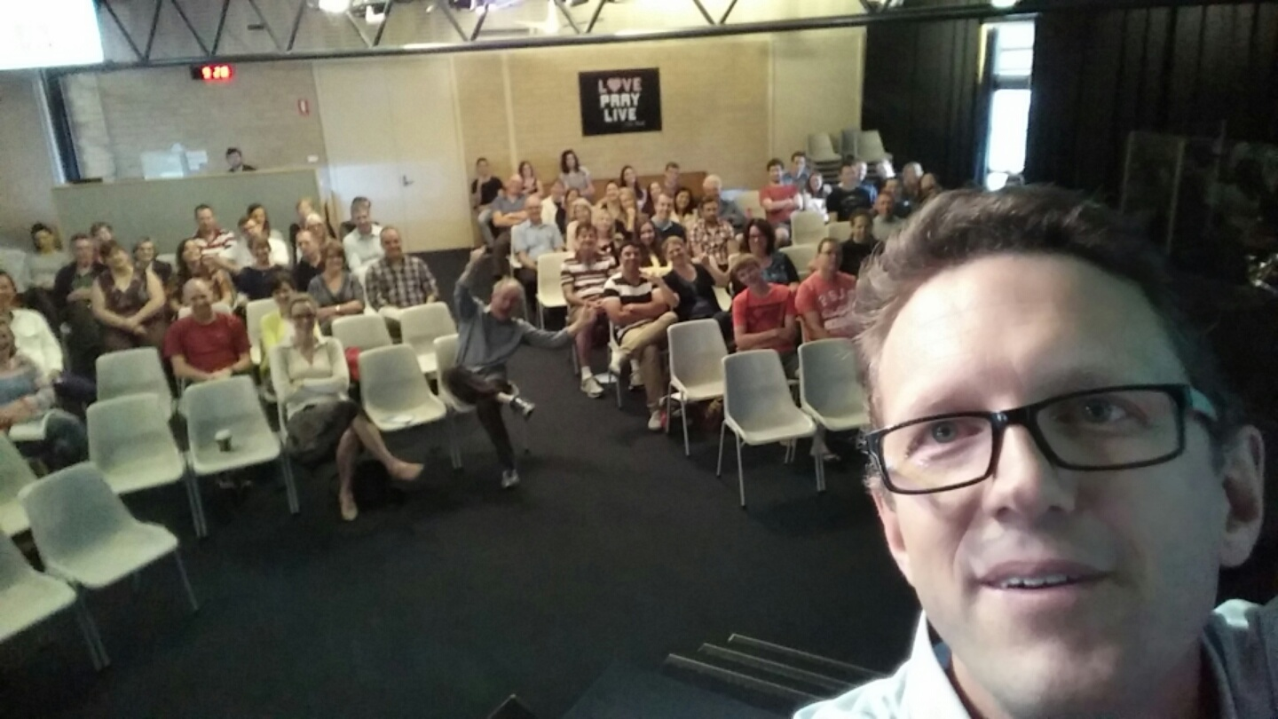
CHURCH “Selfie” (Last Sunday)

Slide 7
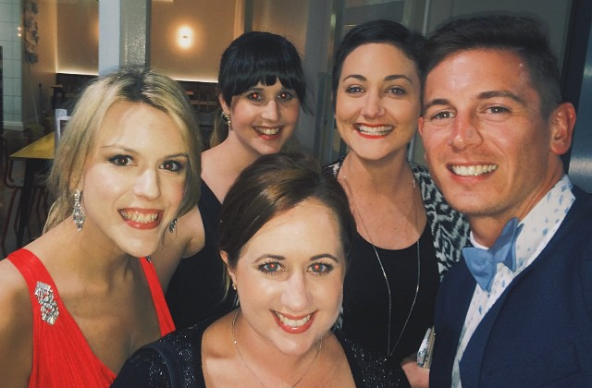
The Appreciation Night “Selfie”

Slide 8
The Quokka “Selfie”

Slide 9
The “EXTENDO” Selfie Stick

Slide 10
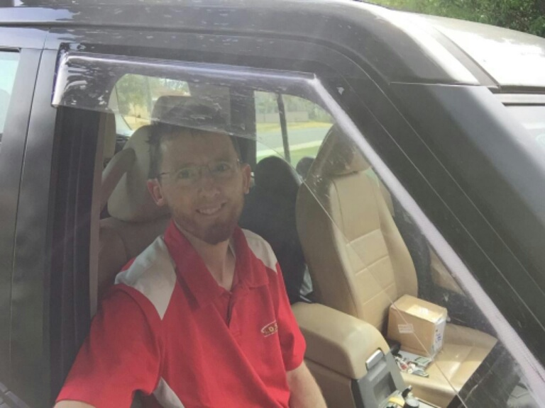
The Macca Selfie Stick “Selfie”

Slide 11
A “Selfie”

Slide 12
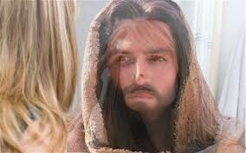
2 Corinthians 3:18 (NAS)
But we all, with unveiled face, beholding as in a mirror the glory of the Lord, are being transformed into the same image from glory to glory, just as from the Lord, the Spirit.

Slide 13
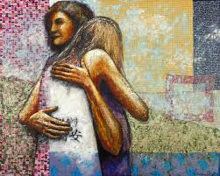
1. OUR ATTITUDE TOWARDS MERCY
Matthew 5:7–12 (NIV)
7 Blessed are the merciful,
for they will be shown mercy.

Slide 14
Ephesians 2:4–6 (NIV)
4 But because of his great love for us, God, who is rich in mercy, 5 made us alive with Christ even when we were dead in transgressions—it is by grace you have been saved. 6 And God raised us up with Christ and seated us with him in the heavenly realms in Christ Jesus,

Slide 15
Spiritual “Selfie?”
Peterson writes “You’re blessed when you care. At the moment of being ‘care-full,’ you find yourselves cared for.

Slide 16
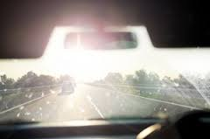
2. OUR ATTITUDE TOWARD PURITY
Matthew 5
8 Blessed are the pure in heart,
for they will see God.

Slide 17
2. OUR ATTITUDE TOWARD PURITY
Barker writes, “It is impossible to have one characteristic without the other. The one who is single-minded in commitment to the kingdom and its righteousness will also be inwardly pure. Inward sham, deceit, and moral filth cannot coexist with sincere devotion to Christ.”

Slide 18
Spiritual “Selfie?”
Peterson says, “You’re blessed when you get your inside world—your mind and heart—put right. Then you can see God in the outside world.

Slide 19
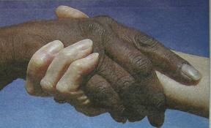
3. OUR ATTITUDE TOWARDS PEACEMAKING
Matthew 5:
9 Blessed are the peacemakers,
for they will be called children of God.

Slide 20
Spiritual “Selfie?”
Peterson says “You’re blessed when you can show people how to cooperate instead of compete or fight. That’s when you discover who you really are, and your place in God’s family

Slide 21
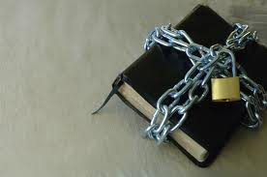
4. OUR ATTITUDE TOWARDS PERSECUTION
Matthew 5:
10 Blessed are those who are persecuted because of righteousness,
for theirs is the kingdom of heaven.

Slide 22
4. OUR ATTITUDE TOWARDS PERSECUTION
Matthew 5:
11 “Blessed are you when people insult you, persecute you and falsely say all kinds of evil against you because of me. 12 Rejoice and be glad, because great is your reward in heaven, for in the same way they persecuted the prophets who were before you.

Slide 23
Spiritual “Selfie?”
Petersen says “You’re blessed when your commitment to God provokes persecution. The persecution drives you even deeper into God’s kingdom.

Slide 24
“The Beatitudes are not a standard for me to achieve but a yardstick by which to measure my submission to the HOLY SPIRIT.”

Slide 25
Romans 10:9 If you declare with your mouth, “Jesus is Lord,” and believe in your heart that God raised him from the dead, you will be saved.

