Slide 1
Matthew 5:1-6
Rod Thom

Slide 3
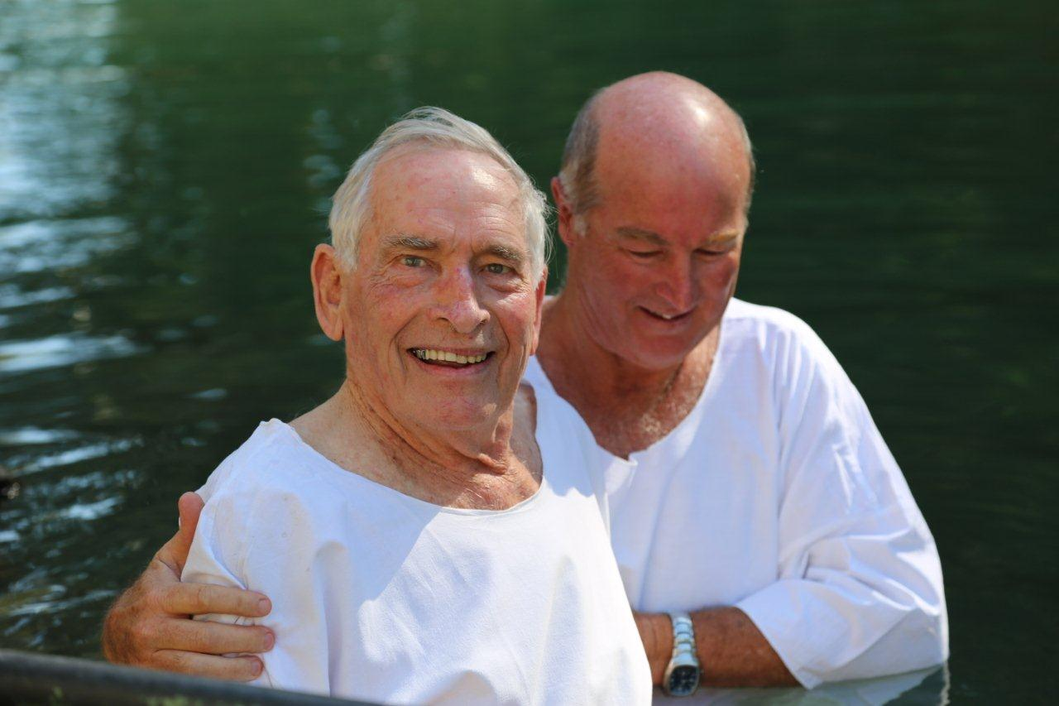
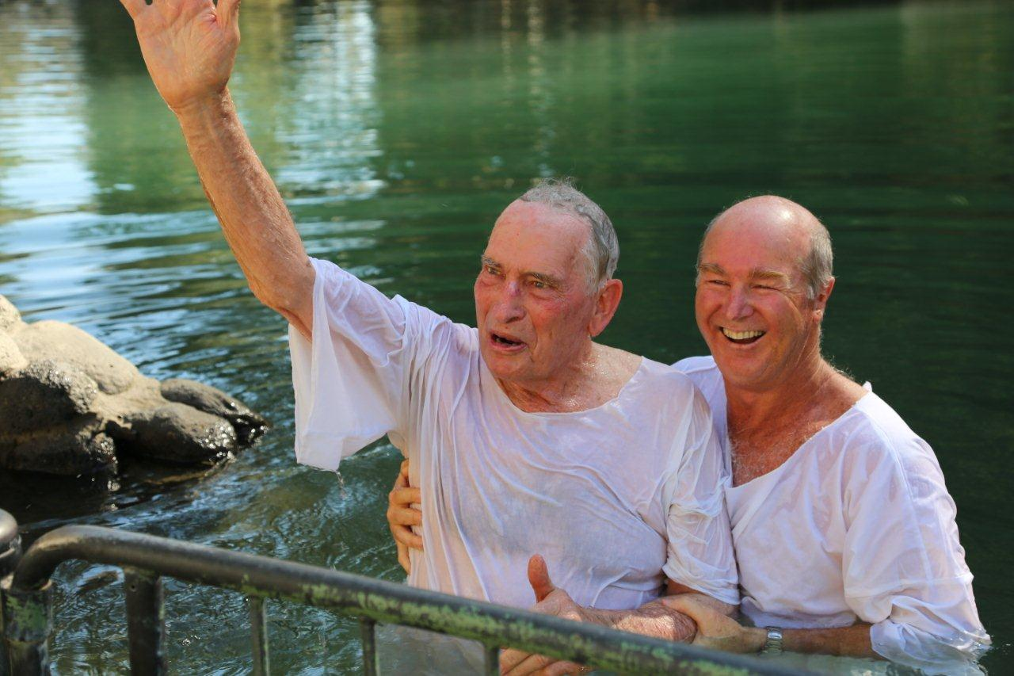
Peter Wahlston Baptised in the Jordan

Slide 4
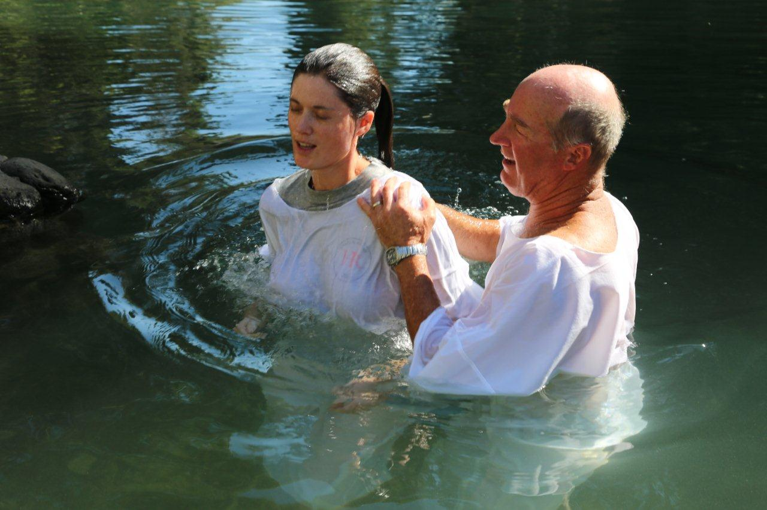
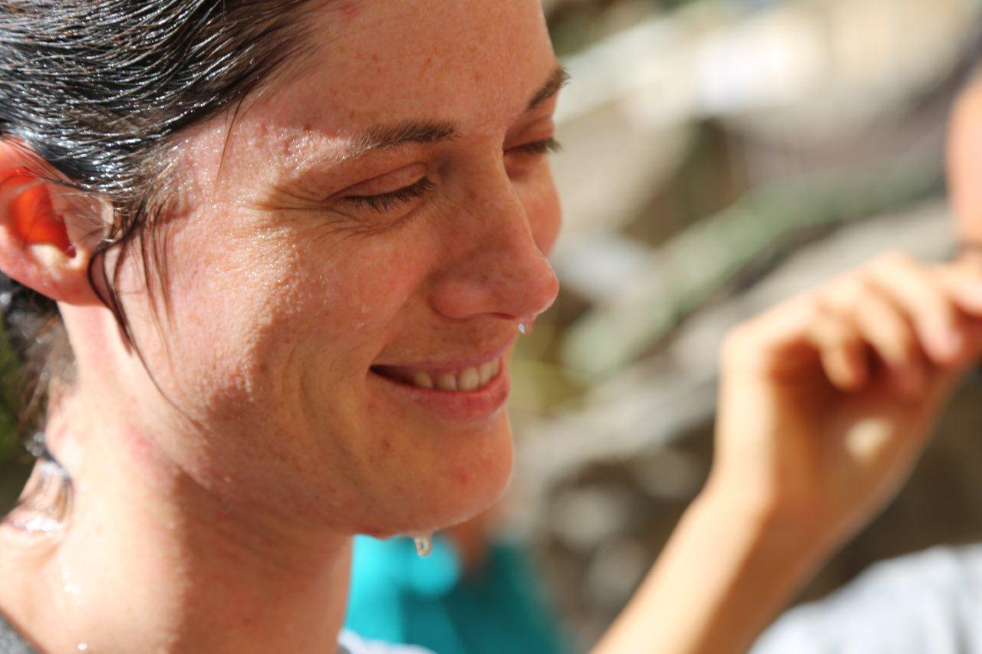
Orit Crombie Baptised in the Jordan

Slide 5
Matthew 5:1-6
Rod Thom

Slide 6
Matthew 4:23–25 (NIV)
23 Jesus went throughout Galilee, teaching in their synagogues, proclaiming the good news of the kingdom, and healing every disease and sickness among the people. 24 News about him spread all over Syria, and people brought to him all who were ill with various diseases, those suffering severe pain, the demon-possessed, those having seizures, and the paralyzed; and he healed them. 25 Large crowds from Galilee, the Decapolis, Jerusalem, Judea and the region across the Jordan followed him.

Slide 7
Matthew 5:1–2 (NIV)
Introduction to the Sermon on the Mount
5 Now when Jesus saw the crowds, he went up on a mountainside and sat down. His disciples came to him,

Slide 8
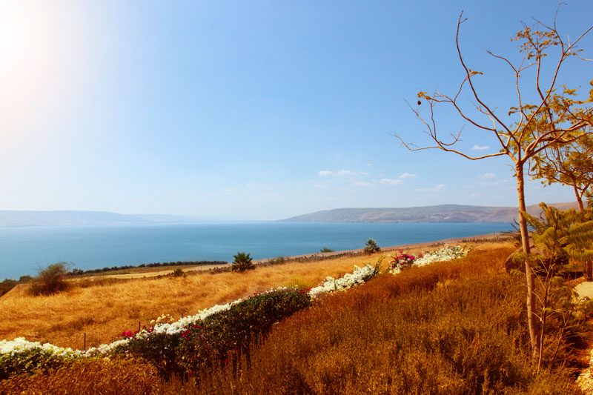

Slide 9
Matthew 5:1–2 (NIV)
Introduction to the Sermon on the Mount
5 Now when Jesus saw the crowds, he went up on a mountainside and sat down. His disciples came to him, 2 and he began to teach them.

Slide 10
A “Selfie”

Slide 11
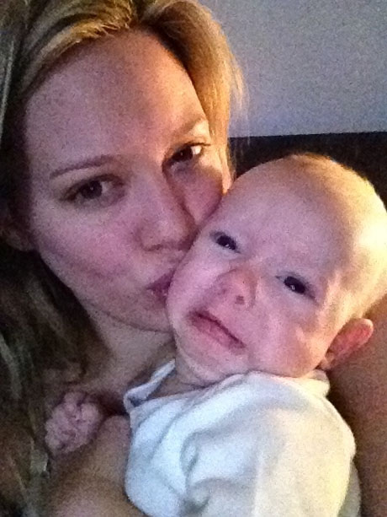
The I’m Terrified “Selfie”

Slide 12
The Duckface “Selfie”

Slide 13
The Baby Photobomb “Selfie”

Slide 14
A “Selfie”

Slide 15
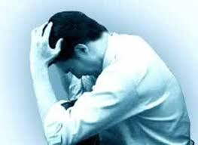
1. OUR ATTITUDE TOWARDS GOD; POOR IN SPIRIT
Matthew 5:3
The Beatitudes
He said:
3 “Blessed are the poor in spirit,
for theirs is the kingdom of heaven.

Slide 16
1. OUR ATTITUDE TOWARDS GOD; POOR IN SPIRIT
“People who are “poor in spirit” are those who are humble before God. They realize that they have nothing in this life that they can contribute to receiving the kingdom of heaven. They have afflicted their souls, meaning that they have humbled themselves and repented with deep sorrow; and they have come to the King as helpless and hopeless sinners. There is no arrogance in them, no self-righteousness, no self-sufficiency. They are free from their own pretensions, and therefore they are free for God. Everyone who wishes to enter the kingdom must be “spiritually poor,” for salvation is a gift from God.”

Slide 17
1. OUR ATTITUDE TOWARDS GOD; POOR IN SPIRIT
Peterson writes “You’re blessed when you’re at the end of your rope. With less of you there is more of God and his rule.

Slide 18
Spiritual “Selfie”

Slide 19
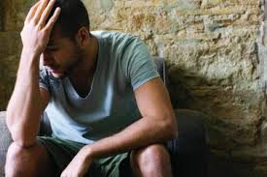
2. OUR ATTITUDE TOWARD SIN; MOURN
Matthew 5:
4 Blessed are those who mourn,
for they will be comforted.

Slide 20
Spiritual “Selfie”

Slide 21
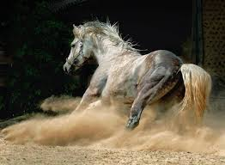
3. OUR ATTITUDE TOWARDS SELF AND OTHERS; MEEK
Matthew 5:
5 Blessed are the meek,
for they will inherit the earth.

Slide 22
3. OUR ATTITUDE TOWARDS SELF AND OTHERS; MEEK
Peterson says “You’re blessed when you’re content with just who you are—no more, no less. That’s the moment you find yourselves proud owners of everything that can’t be bought.

Slide 23
Spiritual “Selfie”

Slide 24
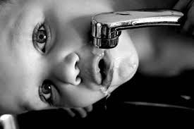
4. OUR ATTITUDE TOWARDS GROWTH; HUNGER & THIRST
Matthew 5:
6 Blessed are those who hunger and thirst for righteousness,
for they will be filled.

Slide 25
4. OUR ATTITUDE TOWARDS GROWTH; HUNGER & THIRST
Peterson says, 6 “You’re blessed when you’ve worked up a good appetite for God. He’s food and drink in the best meal you’ll ever eat. Righteousness brings Satisfaction!

Slide 26
Spiritual “Selfie”

Slide 27
“The Beatitudes are not a standard for me to achieve but a yardstick by which to measure my submission to the HOLY SPIRIT.”

