Slide 1
1 Timothy 6:11-21
Rod Thom

Slide 2
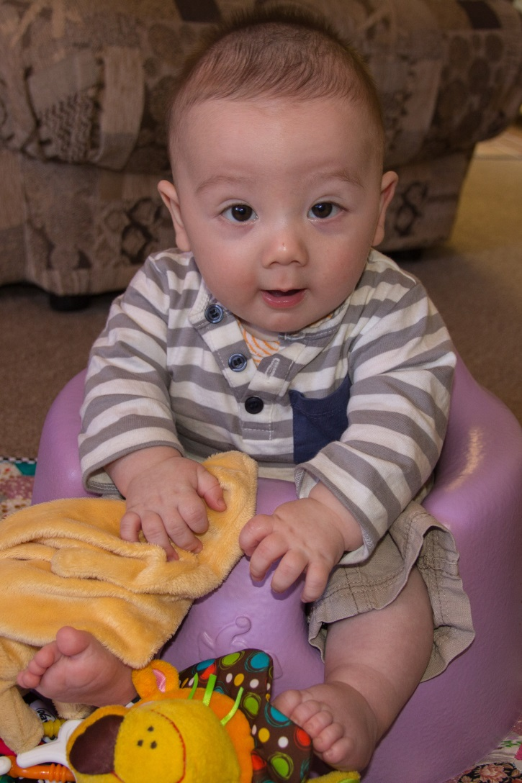
Liam Southgate Beaver

Slide 3
The Final Five Words starting with the letter “F”
1 Timothy 6:11-21

Slide 5
1 Timothy 6:11-21
1 Timothy 6:11 (NIV) But you, man of God, flee from all this, and pursue righteousness, godliness, faith, love, endurance and gentleness. 12 Fight the good fight of the faith. Take hold of the eternal life to which you were called when you made your good confession in the presence of many witnesses.

Slide 6
1 Timothy 6:11-21
13 In the sight of God, who gives life to everything, and of Christ Jesus, who while testifying before Pontius Pilate made the good confession, I charge you 14 to keep this command without spot or blame until the appearing of our Lord Jesus Christ, 15 which God will bring about in his own time—God, the blessed and only Ruler, the King of kings and Lord of lords, 16 who alone is immortal and who lives in unapproachable light, whom no one has seen or can see. To him be honor and might forever. Amen.

Slide 7
1. FLEE
1 Timothy 6:11 But you, man of God, flee from all this,

Slide 8
2. FOLLOW
11b and pursue righteousness, godliness, faith, love, endurance and gentleness.

Slide 9
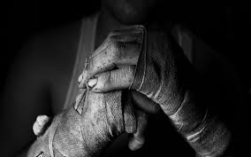
3. FIGHT
12 Fight the good fight of the faith. Take hold of the eternal life to which you were called when you made your good confession in the presence of many witnesses.

Slide 10
4. FINANCES
17 Command those who are rich in this present world not to be arrogant nor to put their hope in wealth, which is so uncertain, but to put their hope in God, who richly provides us with everything for our enjoyment. 18 Command them to do good, to be rich in good deeds, and to be generous and willing to share. 19 In this way they will lay up treasure for themselves as a firm foundation for the coming age, so that they may take hold of the life that is truly life.

Slide 12
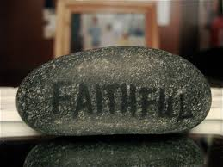
5. FAITHFUL
20 Timothy, guard what has been entrusted to your care. Turn away from godless chatter and the opposing ideas of what is falsely called knowledge, 21 which some have professed and in so doing have departed from the faith.

Slide 13
5. FAITHFUL
21b Grace be with you all.

Slide 14
Take Hold of Your Kingdom Life

