Slide 2
1 Timothy 6:1-10
Rod Thom

Slide 3
Church Update

Slide 4
Keys to Kingdom Life Contentment
1 Timothy 6:1-10

Slide 6
Keys to Kingdom Life Contentment
1 Timothy 6:1-10

Slide 7
Keys to Kingdom Life Contentment
What is Contentment?
I believe PAUL defines it as;
an attitude of the mind, independent of external circumstances, that’s dependent upon God.

Slide 8
1 Timothy 6:1-10
6:1 All who are under the yoke of slavery should consider their masters worthy of full respect, so that God’s name and our teaching may not be slandered. 2 Those who have believing masters should not show them disrespect just because they are fellow believers. Instead, they should serve them even better because their masters are dear to them as fellow believers and are devoted to the welfare of their slaves.

Slide 9
1. THE FIRST KEY TO KINGDOM LIFE CONTENTMENT; is viewing your work as service to God

Slide 10
1 Timothy 6:1-10
6:2b These are the things you are to teach and insist on. 3 If anyone teaches otherwise and does not agree to the sound instruction of our Lord Jesus Christ and to godly teaching, 4 they are conceited and understand nothing. They have an unhealthy interest in controversies and quarrels about words that result in envy, strife, malicious talk, evil suspicions 5 and constant friction between people of corrupt mind, who have been robbed of the truth and who think that godliness is a means to financial gain.

Slide 11
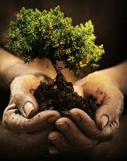
2. THE SECOND KEY TO KINGDOM LIFE CONTENTMENT; can be found in nurturing your Kingdom Life. (Cultivating accurate beliefs and exercising spiritual practices)

Slide 12
1 Timothy 6:1-10
6 But godliness with contentment is great gain. 7 For we brought nothing into the world, and we can take nothing out of it. 8 But if we have food and clothing, we will be content with that. 9 Those who want to get rich fall into temptation and a trap and into many foolish and harmful desires that plunge people into ruin and destruction. 10 For the love of money is a root of all kinds of evil. Some people, eager for money, have wandered from the faith and pierced themselves with many griefs.

Slide 13
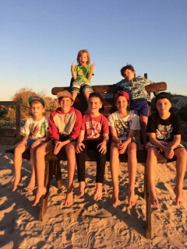
3. THE THIRD KEY TO KINGDOM LIFE CONTENTMENT; can be found in focusing on what’s most important in life.
John 18:36 Jesus said, “My kingdom is not of this world.”

Slide 14
3 Keys to Kingdom Life Contentment
1 Timothy 6:1-10

