Slide 1
Taking Hold of Your Kingdom Life
1 Timothy Introduction

Slide 2
Who are the people who have profoundly impacted your spiritual life?

Slide 3
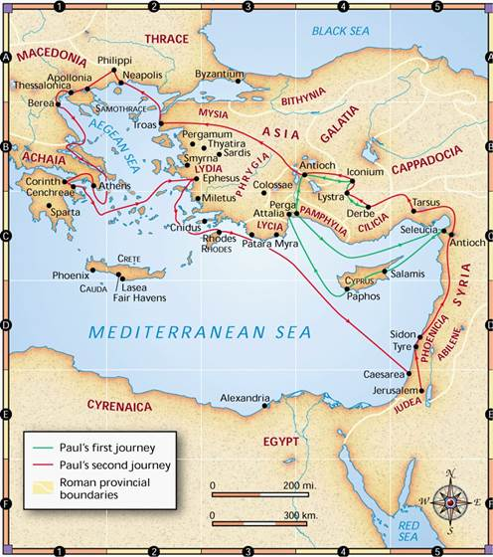

Slide 4
Ephesus:
Multicultural, political, economic and religious centre
Diversity of culture, cults and ethnicity
Temple of Artermis

Slide 6
1 Timothy 4:11-16 (The Message)
11-14 Get the word out. Teach all these things. And don’t let anyone put you down because you’re young. Teach believers with your life: by word, by demeanor, by love, by faith, by integrity. Stay at your post reading Scripture, giving counsel, teaching. And that special gift of ministry you were given when the leaders of the church laid hands on you and prayed—keep that dusted off and in use.
15-16 Cultivate these things. Immerse yourself in them. The people will all see you mature right before their eyes! Keep a firm grasp on both your character and your teaching. Don’t be diverted. Just keep at it. Both you and those who hear you will experience salvation.

Slide 7
1 Timothy 6:11,12 (NIV)
‘…pursue righteousness, godliness, faith, love, endurance and gentleness. 12 Fight the good fight of the faith. Take hold of the eternal life to which you were called when you made your good confession in the presence of many witnesses.’

Slide 8
1 Timothy 1:15-17 (NIV)
15 Here is a trustworthy saying that deserves full acceptance: Christ Jesus came into the world to save sinners—of whom I am the worst. 16 But for that very reason I was shown mercy so that in me, the worst of sinners, Christ Jesus might display his immense patience as an example for those who would believe in him and receive eternal life. 17 Now to the King eternal, immortal, invisible, the only God, be honour and glory for ever and ever. Amen.

Slide 9
1 Timothy 2:5,6 (NIV)
5For there is one God and one mediator between God and mankind, the man Christ Jesus, 6 who gave himself as a ransom for all people.

