Slide 1
Core Values
Inspiring Community Celebration

Slide 2
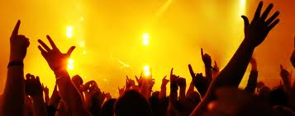
WORSHIP
Inspiring Community Celebration:
Lifestreams is committed to worship that passionately exalts Christ, bringing people into the tangible presence of God, inspiring hope and faith.

Slide 3
WORSHIP
Psalm 96
1 Sing to the LORD a new song;
sing to the LORD, all the earth.
2 Sing to the LORD, praise his name;
proclaim his salvation day after day.
3 Declare his glory among the nations,
his marvellous deeds among all peoples.

Slide 4
WORSHIP
4 For great is the LORD and most worthy of praise;
he is to be feared above all gods. 5 For all the gods of the nations are idols,
but the LORD made the heavens.
6 Splendor and majesty are before him;
strength and glory are in his sanctuary.

Slide 5
WORSHIP
7 Ascribe to the LORD, all you families of nations,
ascribe to the LORD glory and strength.
8 Ascribe to the LORD the glory due his name;
bring an offering and come into his courts.
9 Worship the LORD in the splendor of his holiness;
tremble before him, all the earth.

Slide 6
WORSHIP
10 Say among the nations, “The LORD reigns.”
The world is firmly established, it cannot be moved;
he will judge the peoples with equity.

Slide 7
WORSHIP
11 Let the heavens rejoice, let the earth be glad;
let the sea resound, and all that is in it.
12 Let the fields be jubilant, and everything in them;
let all the trees of the forest sing for joy.

Slide 8
WORSHIP
13 Let all creation rejoice before the LORD, for he comes,
he comes to judge the earth.
He will judge the world in righteousness
and the peoples in his faithfulness.

Slide 9
PRAISE & PROCLAMATION
We SING
Psalm 96
1 Sing to the LORD a new song;
sing to the LORD, all the earth.
2 Sing to the LORD, praise his name;

Slide 10
PRAISE & PROCLAMATION
We PROCLAIM
V2a proclaim his salvation day after day.
3 Declare his glory among the nations,
his marvellous deeds among all peoples.

Slide 11
FOCUS
4 For great is the LORD and most worthy of praise;
he is to be feared above all gods.
5 For all the gods of the nations are idols,
but the LORD made the heavens.
6 Splendor and majesty are before him;
strength and glory are in his sanctuary.

Slide 12
SACRIFICE
7 Ascribe to the LORD, all you families of nations,
ascribe to the LORD glory and strength.
8 Ascribe to the LORD the glory due his name;
bring an offering and come into his courts.
9 Worship the LORD in the splendor of his holiness;
tremble before him, all the earth.

Slide 13
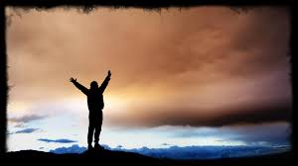
SACRIFICE
1. Living Sacrifice
Sacrifice of Praise
Offer/give our Resources

Slide 14
WORSHIP
10 Say among the nations, “The LORD reigns.”
The world is firmly established, it cannot be moved;
he will judge the peoples with equity.

Slide 15
WORSHIP
11 Let the heavens rejoice, let the earth be glad;
let the sea resound, and all that is in it.
12 Let the fields be jubilant, and everything in them;
let all the trees of the forest sing for joy.

Slide 16
WORSHIP
13 Let all creation rejoice before the LORD, for he comes,
he comes to judge the earth.
He will judge the world in righteousness
and the peoples in his faithfulness.

Slide 17
Our Response?

