Slide 1
Core Values
Every Christ Follower Actively Involved
in Ministry

Slide 2
You are not a commodity to Christ and the church and neither should the church and Christ be a commodity to you.
We need to get off that treadmill …

Slide 3
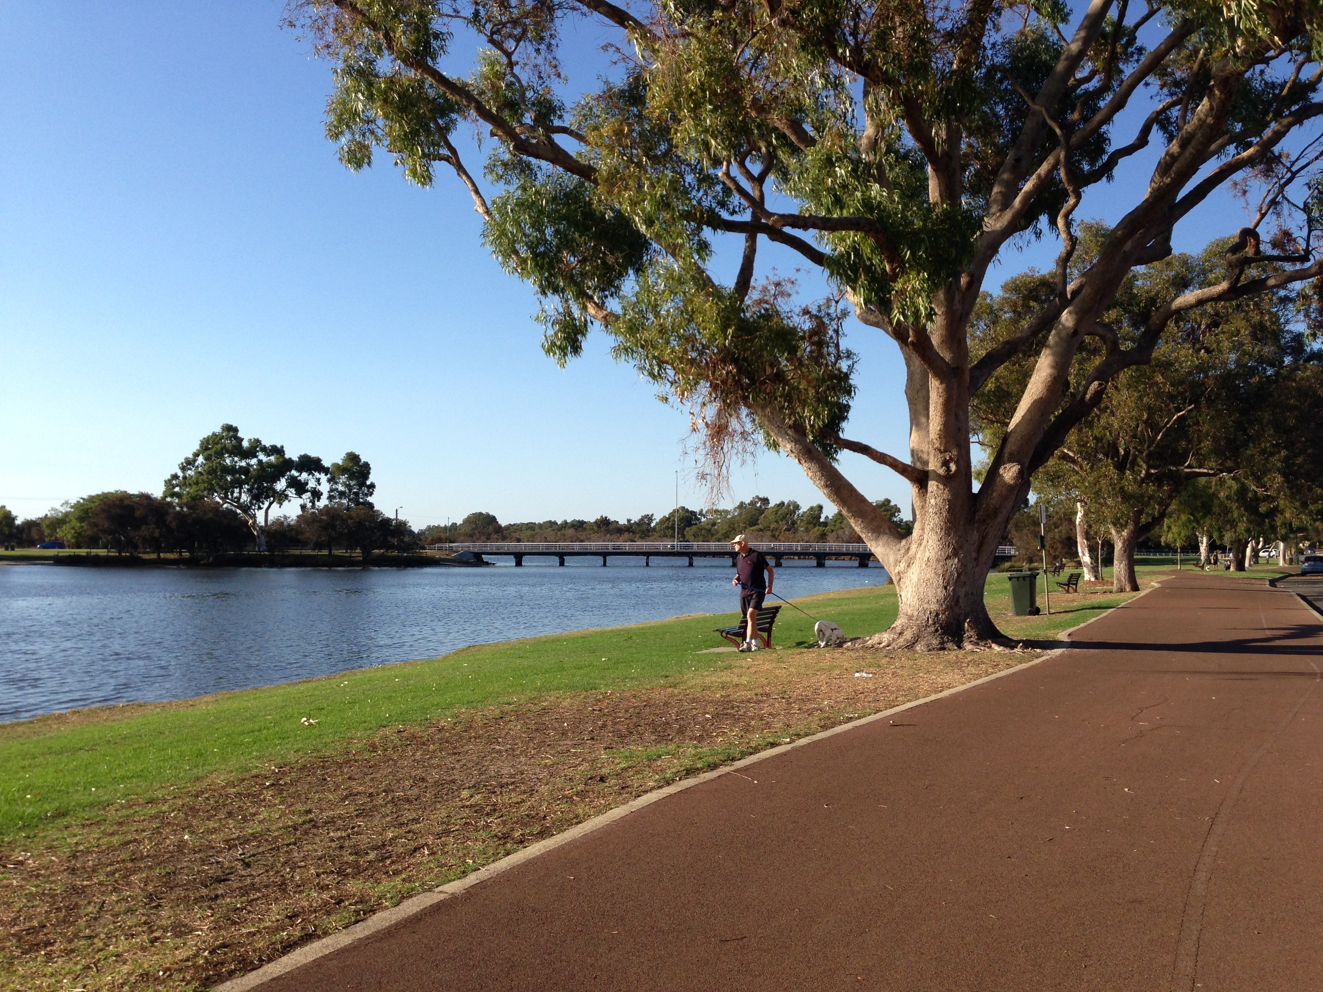

Slide 4
Galatians 5
The Life of Freedom
Christ has set us free to live a free life. So take your stand! Never again let anyone put a harness of slavery on you.
I am emphatic about this. The moment any one of you submits to circumcision or any other rule-keeping system, at that same moment Christ’s hard-won gift of freedom is squandered. I repeat my warning: The person who accepts the ways of circumcision trades all the advantages of the free life in Christ for the obligations of the slave life of the law.

Slide 5
Galatians 5
The Life of Freedom
I suspect you would never intend this, but this is what happens. When you attempt to live by your own religious plans and projects, you are cut off from Christ, you fall out of grace. Meanwhile we expectantly wait for a satisfying relationship with the Spirit. For in Christ, neither our most conscientious religion nor disregard of religion amounts to anything. What matters is something far more interior: faith expressed in love.

Slide 6
Galatians 5
The Life of Freedom
You were running superbly! Who cut in on you, deflecting you from the true course of obedience? This detour doesn’t come from the One who called you into the race in the first place. And please don’t toss this off as insignificant. It only takes a minute amount of yeast, you know, to permeate an entire loaf of bread.

Slide 7
1. Active participation as a follower of Jesus is not motivated by rules.

Slide 8
Galatians 5
The Life of Freedom
My counsel is this: Live freely, animated and motivated by God’s Spirit. Then you won’t feed the compulsions of selfishness. For there is a root of sinful self-interest in us that is at odds with a free spirit, just as the free spirit is incompatible with selfishness. These two ways of life are antithetical, so that you cannot live at times one way and at times another way according to how you feel on any given day. Why don’t you choose to be led by the Spirit and so escape the erratic compulsions of a law-dominated existence?

Slide 9
1. Active participation as a follower of Jesus is not motivated by rules.
2. Active participation as a follower of Jesus is always motivated by Christian love.

Slide 10
Galatians 5
The Life of Freedom
It is absolutely clear that God has called you to a free life. Just make sure that you don’t use this freedom as an excuse to do whatever you want to do and destroy your freedom. Rather, use your freedom to serve one another in love; that’s how freedom grows. For everything we know about God’s Word is summed up in a single sentence: Love others as you love yourself. That’s an act of true freedom.

Slide 11
1. Active participation as a follower of Jesus is not motivated by rules.
2. Active participation as a follower of Jesus is always motivated by Christian love.
3. It’s in our DNA to be an active participant in/with Christ!

Slide 12
Galatians 5
The Life of Freedom
But what happens when we live God’s way? He brings gifts into our lives, much the same way that fruit appears in an orchard—things like affection for others, exuberance about life, serenity. We develop a willingness to stick with things, a sense of compassion in the heart, and a conviction that a basic holiness permeates things and people. We find ourselves involved in loyal commitments, not needing to force our way in life, able to marshal and direct our energies wisely.

Slide 13
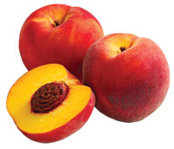
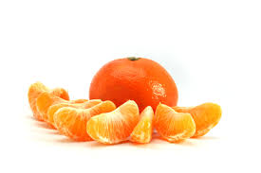
Life is a peach, not an orange …

Slide 14
Galatians 5
The Life of Freedom
Legalism is helpless in bringing this about; it only gets in the way. Among those who belong to Christ, everything connected with getting our own way and mindlessly responding to what everyone else calls necessities is killed off for good—crucified.

Slide 15
Galatians 5
The Life of Freedom
Since this is the kind of life we have chosen, the life of the Spirit, let us make sure that we do not just hold it as an idea in our heads or a sentiment in our hearts, but work out its implications in every detail of our lives. That means we will not compare ourselves with each other as if one of us were better and another worse. We have far more interesting things to do with our lives. Each of us is an original.

