Slide 1
Rod Thom
Luke 2:21-52

Slide 2
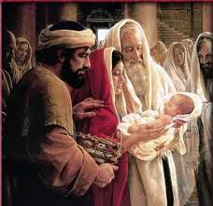
PARENTING JESUS
Luke2:21 On the eighth day, when it was time to circumcise the child, he was named Jesus, the name the angel had given him before he was conceived.

Slide 3
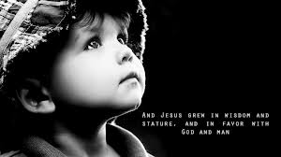
PARENTING JESUS
Luke2:39 When Joseph and Mary had done everything required by the Law of the Lord, they returned to Galilee to their own town of Nazareth. 40 And the child grew and became strong; he was filled with wisdom, and the grace of God was on him.

Slide 4
PARENTING JESUS
The Boy Jesus at the Temple
Luke 2:41 Every year Jesus’ parents went to Jerusalem for the Festival of the Passover. 42 When he was twelve years old, they went up to the festival, according to the custom.

Slide 5
PARENTING JESUS
43 After the festival was over, while his parents were returning home, the boy Jesus stayed behind in Jerusalem, but they were unaware of it. 44 Thinking he was in their company, they travelled on for a day. Then they began looking for him among their relatives and friends. 45 When they did not find him, they went back to Jerusalem to look for him.

Slide 6
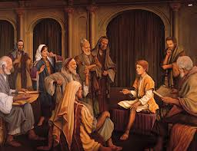
PARENTING JESUS
46 After three days they found him in the temple courts, sitting among the teachers, listening to them and asking them questions. 47 Everyone who heard him was amazed at his understanding and his answers.

Slide 7
PARENTING JESUS
48 When his parents saw him, they were astonished. His mother said to him, “Son, why have you treated us like this? Your father and I have been anxiously searching for you.”
49 “Why were you searching for me?” he asked. “Didn’t you know I had to be in my Father’s house?” d 50 But they did not understand what he was saying to them.

Slide 8
PARENTING JESUS
51 Then he went down to Nazareth with them and was obedient to them. But his mother treasured all these things in her heart. 52 And Jesus grew in wisdom and stature, and in favour with God and man.

Slide 9
PARENTING JESUS
51 Then he went down to Nazareth with them and was obedient to them. But his mother treasured all these things in her heart. 52 And Jesus grew in wisdom and stature, and in favour with God and man.
Jesus grew mentally, physically, spiritually and socially

Slide 10
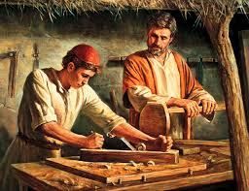
PARENTING JESUS
Jesus Grew…
-IN WISDOM
-IN STATURE
-FAVOUR WITH GOD
-FAVOUR WITH MAN

Slide 11
PARENTING JESUS
SO WHAT?

Slide 12
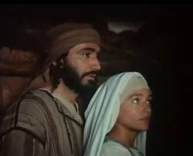
PARENTING JESUS
Principle: They made God’s Word central to their family
Principle: They encouraged Jesus to participate in spiritual activities
Principle: They set an example
PRAYER

