Slide 2
Do not let your hearts be troubled
David Stanford

Slide 4
John 14:1 ‘Do not let your hearts be troubled. You trust in God; trust also in me. 2 My Father’s house has many rooms; if that were not so, would I have told you that I am going there to prepare a place for you? 3 And if I go and prepare a place for you, I will come back and take you to be with me that you also may be where I am. 4 You know the way to the place where I am going.’
5 Thomas said to him, ‘Lord, we don’t know where you are going, so how can we know the way?’

Slide 5
6 Jesus answered, ‘I am the way and the truth and the life. No one comes to the Father except through me. 7 If you really know me, you will know my Father as well. From now on, you do know him and have seen him.’
8 Philip said, ‘Lord, show us the Father and that will be enough for us.’
9 Jesus answered: ‘Don’t you know me, Philip, even after I have been among you such a long time? Anyone who has seen me has seen the Father. How can you say, “Show us the Father”? 10 Don’t you believe that I am in the Father, and that the Father is in me? The words I say to you I do not speak on my own authority. Rather, it is the Father, living in me, who is doing his work.

Slide 6
11 Believe me when I say that I am in the Father and the Father is in me; or at least believe on the evidence of the works themselves. 12 Very truly I tell you, whoever believes in me will do the works I have been doing, and they will do even greater things than these, because I am going to the Father. 13 And I will do whatever you ask in my name, so that the Father may be glorified in the Son. 14 You may ask me for anything in my name, and I will do it.

Slide 7
14:1,27
Do not let you hearts be troubled…
Jesus reassures His disciples

Slide 8
Betrothal imagery
We have all been created for intimacy

Slide 9
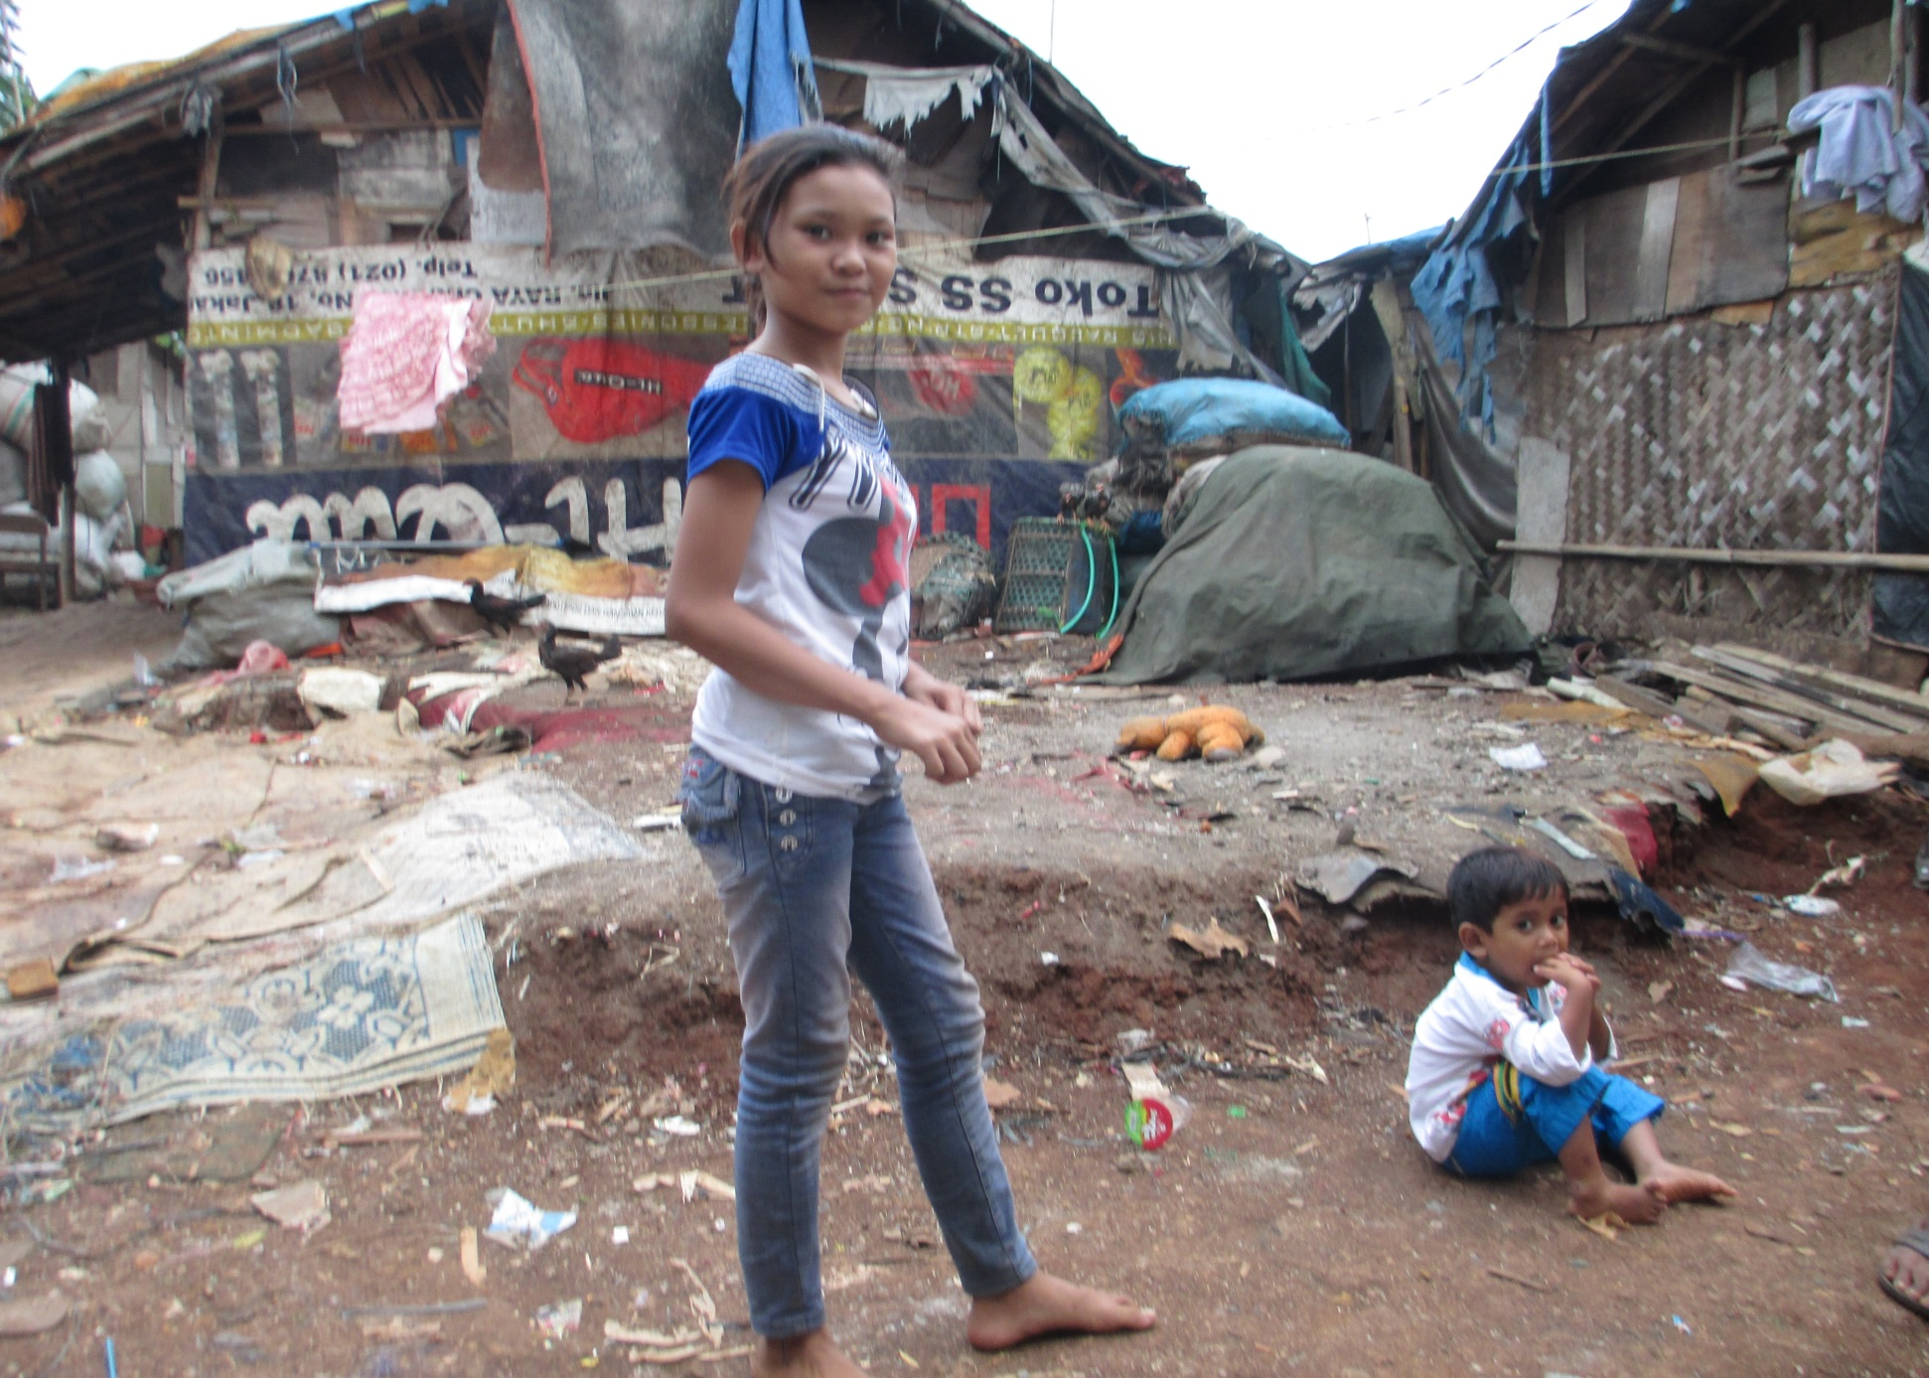

Slide 10
John 14 is a love story
The implication of John 14 is that intimacy is the goal of the gospel.

Slide 11
Do not let your hearts be troubled:
If you have seen me then you have seen the Father
In God there is only Christlikeness

Slide 12
13 And I will do whatever you ask in my name, so that the Father may be glorified in the Son. 14 You may ask me for anything in my name, and I will do it
Do not be troubled: You can talk with me at any time

Slide 13
John 14:15-27
15 ‘If you love me, keep my commands. 16 And I will ask the Father, and he will give you another advocate to help you and be with you for ever – 17 the Spirit of truth. The world cannot accept him, because it neither sees him nor knows him. But you know him, for he lives with you and will be in you. 18 I will not leave you as orphans; I will come to you. 19 Before long, the world will not see me any more, but you will see me. Because I live, you also will live.

Slide 14
20 On that day you will realise that I am in my Father, and you are in me, and I am in you. 21 Whoever has my commands and keeps them is the one who loves me. The one who loves me will be loved by my Father, and I too will love them and show myself to them.’
22 Then Judas (not Judas Iscariot) said, ‘But, Lord, why do you intend to show yourself to us and not to the world?’

Slide 15
23 Jesus replied, ‘Anyone who loves me will obey my teaching. My Father will love them, and we will come to them and make our home with them. 24 Anyone who does not love me will not obey my teaching. These words you hear are not my own; they belong to the Father who sent me.
25 ‘All this I have spoken while still with you. 26 But the Advocate, the Holy Spirit, whom the Father will send in my name, will teach you all things and will remind you of everything I have said to you. 27 Peace I leave with you; my peace I give you. I do not give to you as the world gives. Do not let your hearts be troubled and do not be afraid.

Slide 16
Do not be troubled…I will not abandon you
My Father will send the Holy Spirit
Advocate
Spirit of truth
With you and in you
Teach you all things
Remind you of what I have told you

Slide 17
NOTE the strong connection between love and obedience
15 ‘If you love me, keep my commands.
21 Whoever has my commands and keeps them is the one who loves me.
23 Jesus replied, ‘Anyone who loves me will obey my teaching. My Father will love them, and we will come to them and make our home with them
24 Anyone who does not love me will not obey my teaching.

Slide 18
The cycle of love and obedience
as we grasp the Father’s love for us…
we love Him…
we obey Him… (joy)
we experience His love and pleasure for us…
we love Him…
we obey Him…(joy)
The cycle continues and overflows to others in your world

Slide 19
Peace
27 Peace I leave with you; my peace I give you. I do not give to you as the world gives. Do not let your hearts be troubled and do not be afraid.

Slide 20
This beautiful relationship with the Father is only available through Jesus
John 14:6 Jesus answered, ‘I am the way and the truth and the life. No one comes to the Father except through me.

Slide 21
v30 Jesus said, ‘… the prince of this world is coming. He has no hold over me…’

